Slide 1

Hospital Analysis using R

Slide 2
A project by :
Garima Kumar (352)
Manu Singh (412)
Aishwarya Mishra(406)
Anusurya(008)

Slide 3
Introduction
This project uses the concepts of data analysis to analyse the best possible hospital for a particular disease out a list of 5 hospitals in delhi.
This project uses the following concepts :
Web scrapping
Data cleaning
Sentimental Analysis
Data visualisation

Slide 4

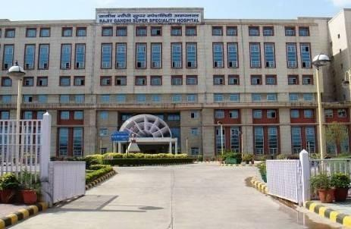
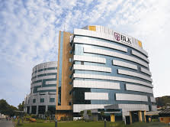
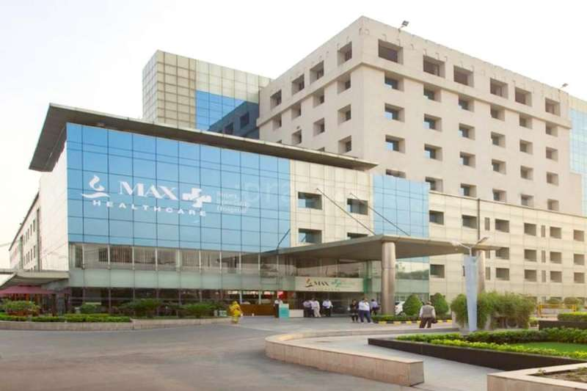
Source Code
Double click on the above image to open the file.

